Slide 1
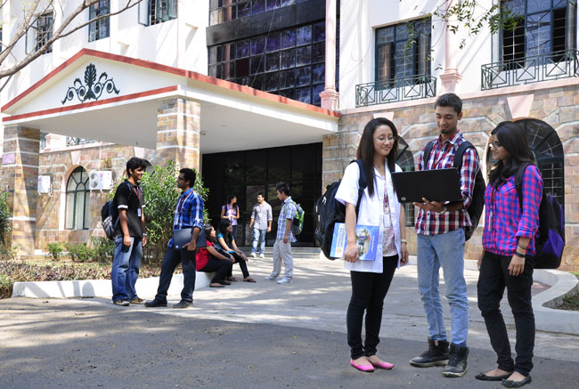

B.Tech Computer Science and Engineering – Vth Semester
Theory of Computation
Department of Computer Science and Engineering

Slide 2
What
A

Slide 3
Thank You .. Have a Great Day

